Slide 1

New Jersey Energy Usage
Team: Grace Wagner, Kshitija Banala, Akhilesh Nimse

Slide 2

Introduction
Purpose: Forecast energy usage for NJ utility companies using weather, economic, and energy data.
Impact: Supports energy efficiency, green energy, and better resource allocation.
Difference: Integrates unique datasets tailored to NJ's climate and population.
Goal: Develop advanced ML models for precise energy demand forecasting.
Beneficiaries: Utility companies, policymakers, NJ residents.

Slide 3
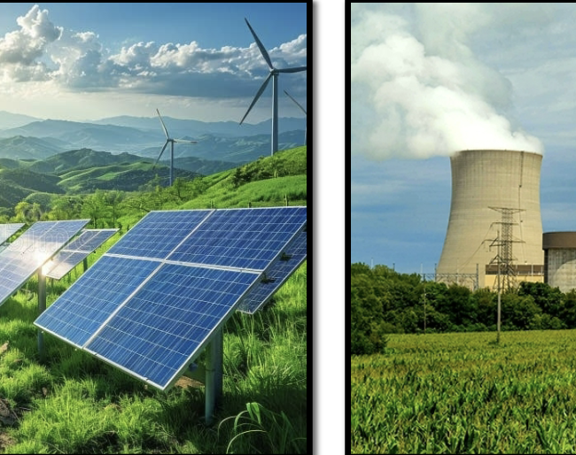
Presentation Overview
Methodology: Data collection, cleaning, and analysis
Machine learning models and their application
Results and Key Insights
Future steps and contributions to the field

Slide 4
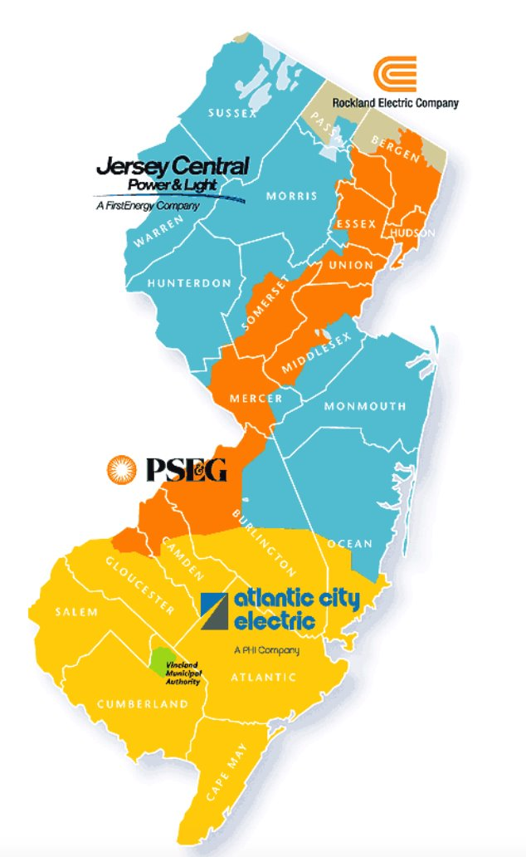
Historic Weather Data Utilization
Weather Data Sources:
Newark (Northern NJ)
Vineland (Southern NJ)
Newark Weather Data:
PSE&G (PSEG)
Jersey Central Power and Light (JCPL)
Rockland Electric Company (RECO)
(Closer geographically to Newark)
Vineland Weather Data:
Atlantic City Electric (ACE)
(Situated closer to Vineland)

Slide 5
Methods
Energy Consumption Forecasts by Gradient Boosting Regression Trees
Luca Di Persio and Nicola Fraccarolo
Forecasting prediction for Italy’s utilities
Highlighted LightGBM’s effectiveness
Lack of focus on financial data
Emulate problem breakdown and explanations

Slide 6







Discussion Question
Weather Features
Temperature
Dew Point
Humidity
Pressure
Wind Speed
Wind Gust
Windy
Cloudy
Snowy
Precipitation
Rain
Fog
Thunderstorm
Fog
Freezing
Date Features
Month
Day
Holiday
Weekend
Weekday
What do you think would be the most valuable feature for this model?

Slide 7
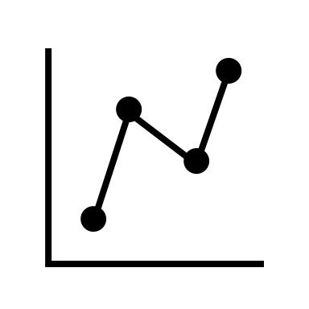


Results
Key Features
Model Performance
Discussion

Slide 8
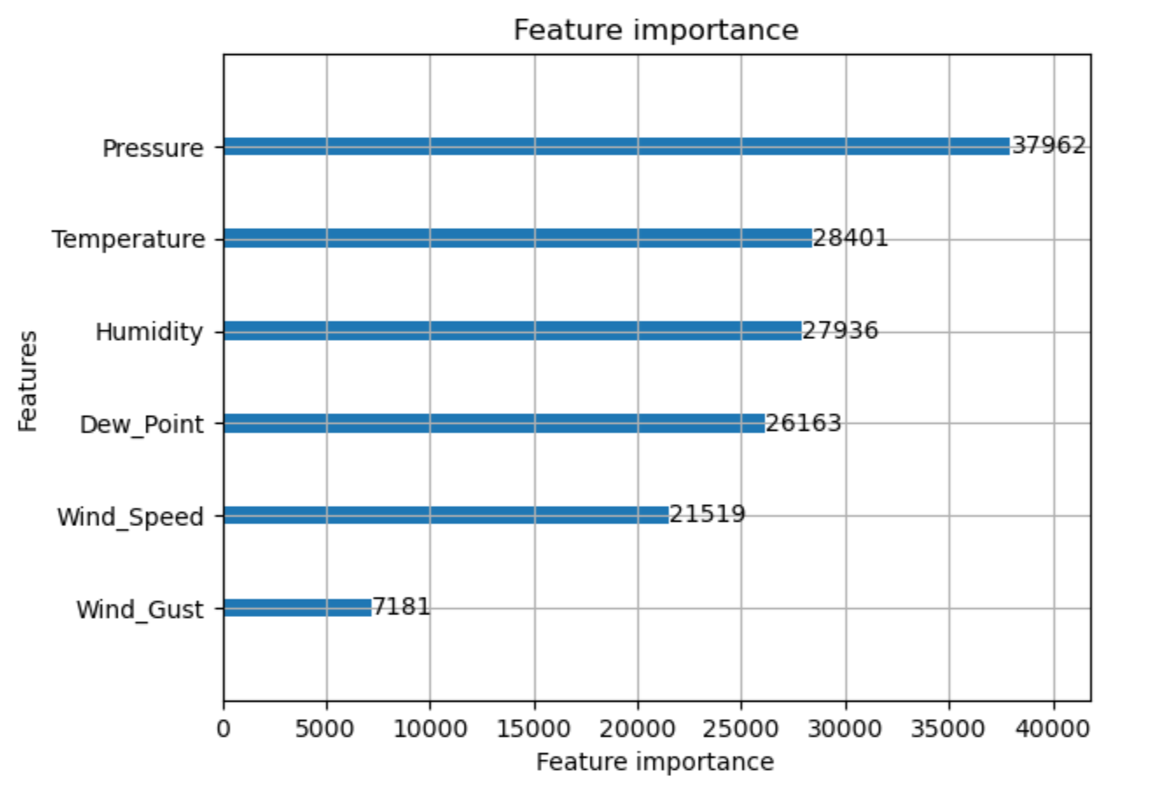
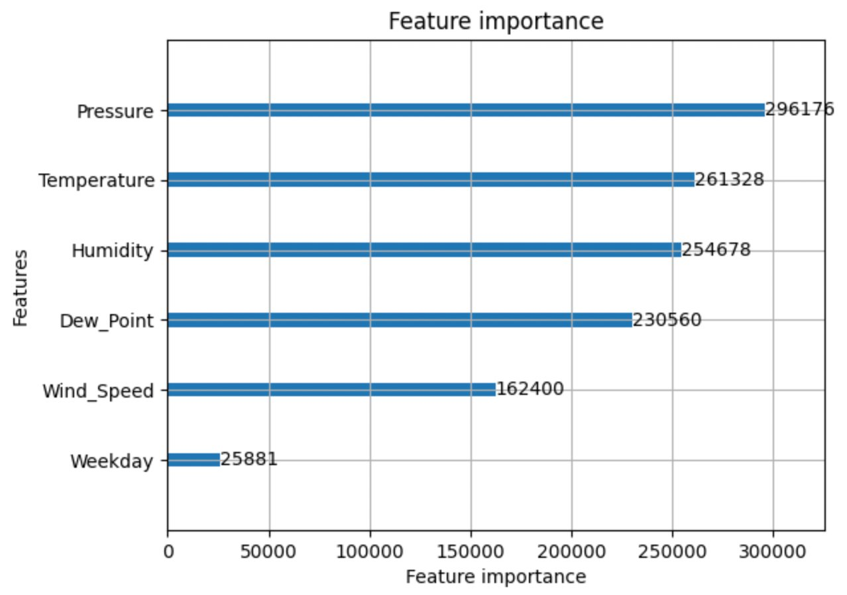
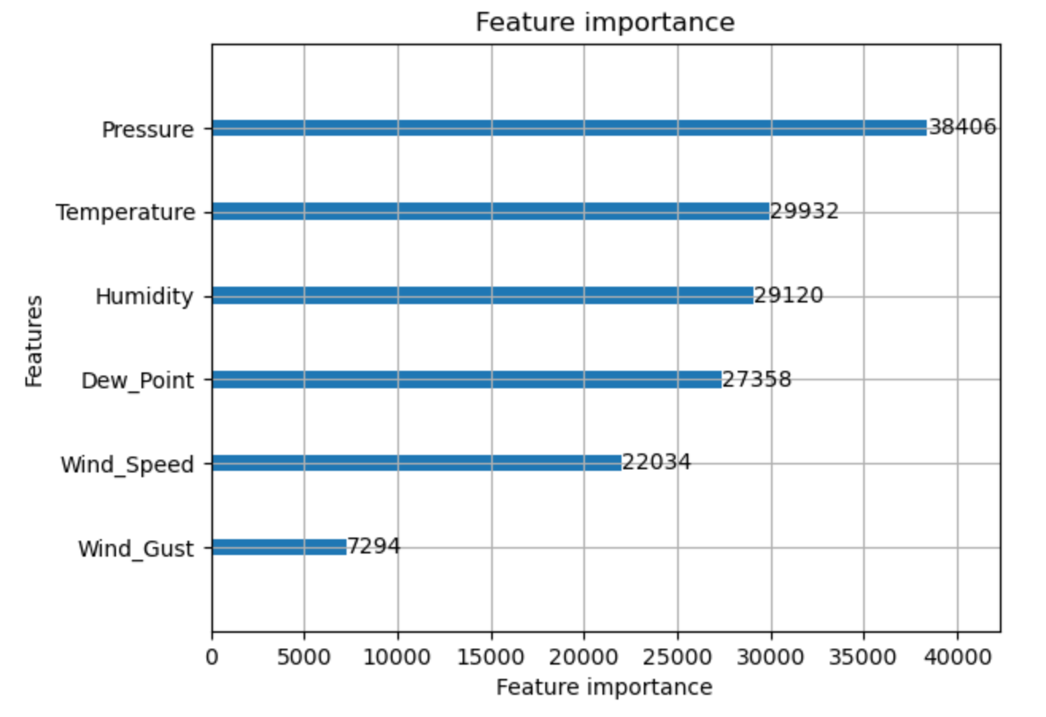
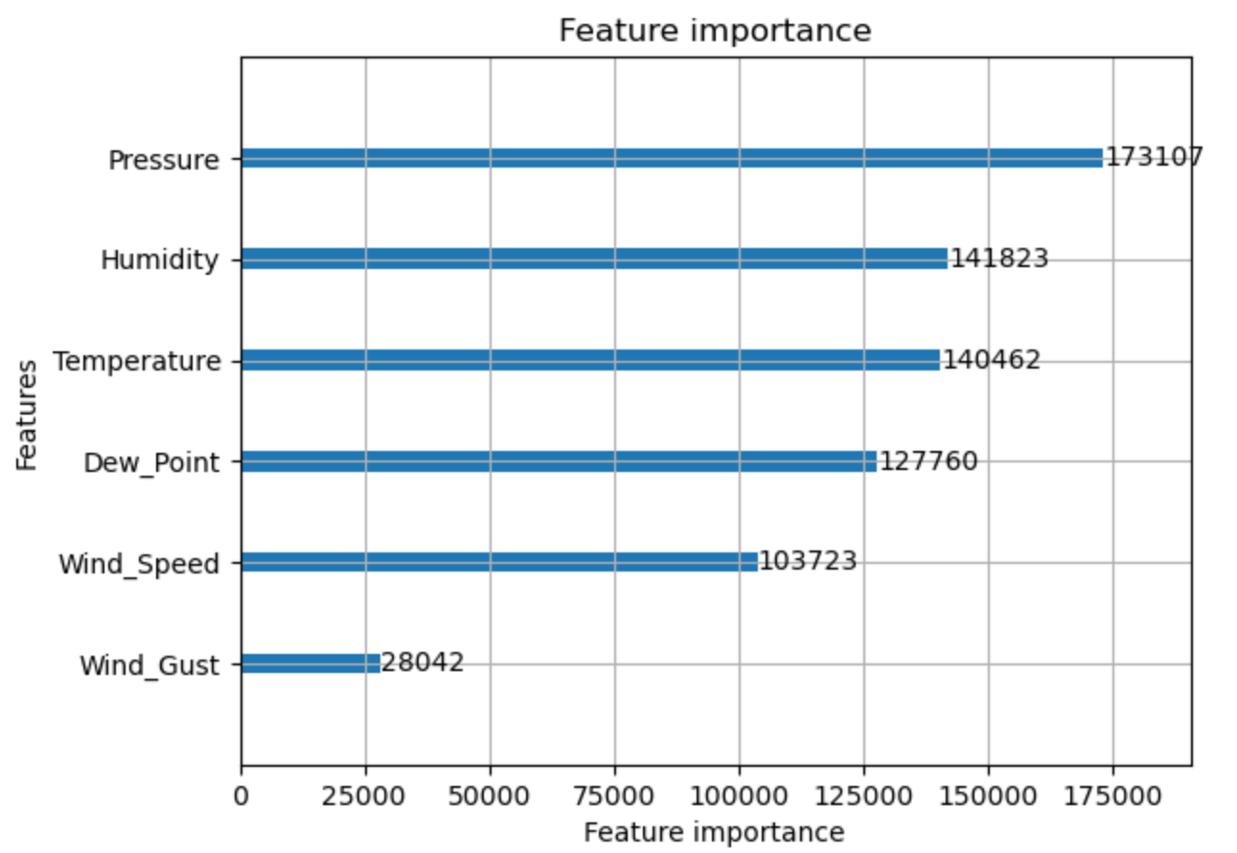
Feature Images
Reco RSCP (Newark)
Reco CIEP (Vineland)
ACE CIEP (Vineland)
ACE RSCP (Newark)

Slide 9
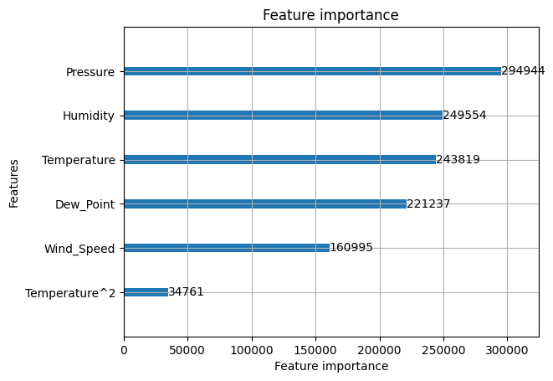
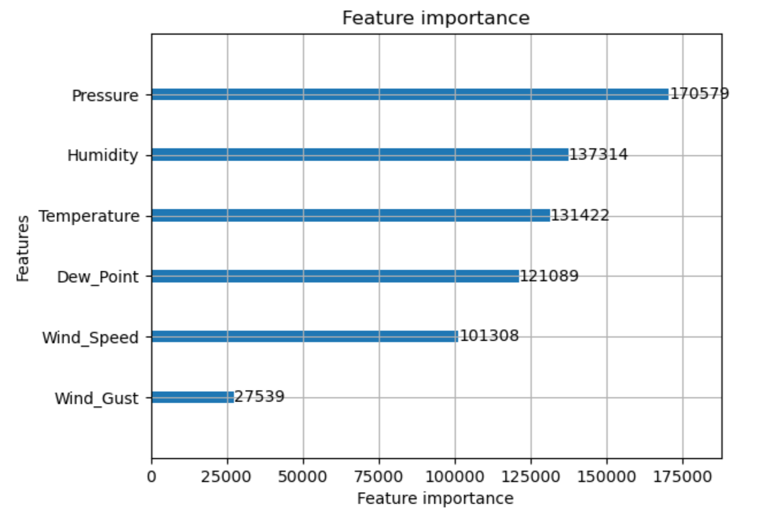
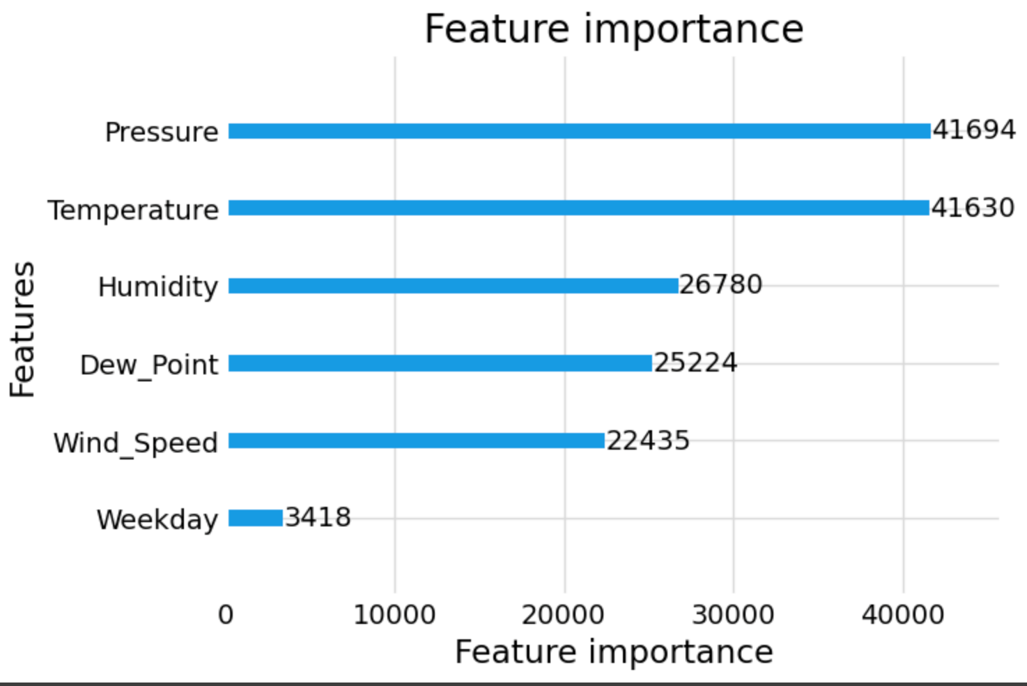
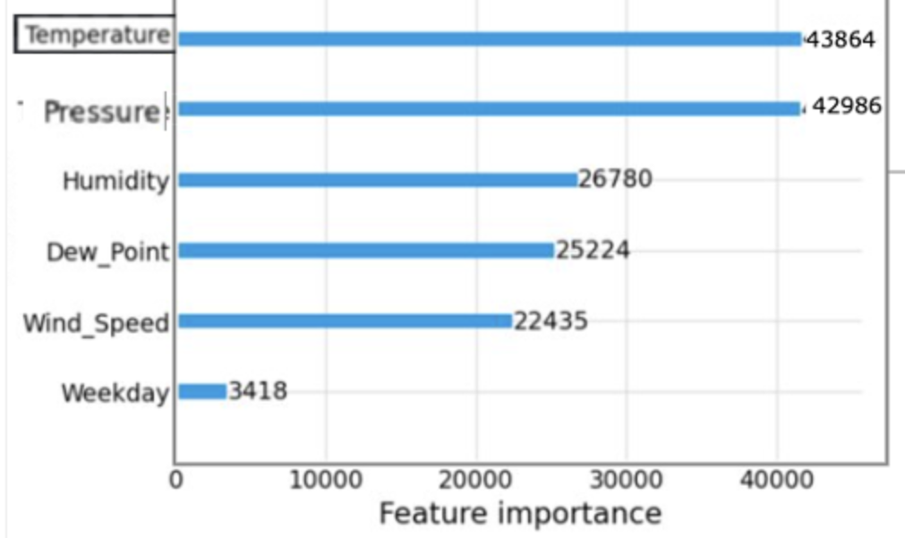
Feature Images
JCPL CIEP (Newark)
JCPL RSCP (Newark) ​
Feature importance
PSEG RSCP (Newark)​
PSEG CIEP (Newark)

Slide 10
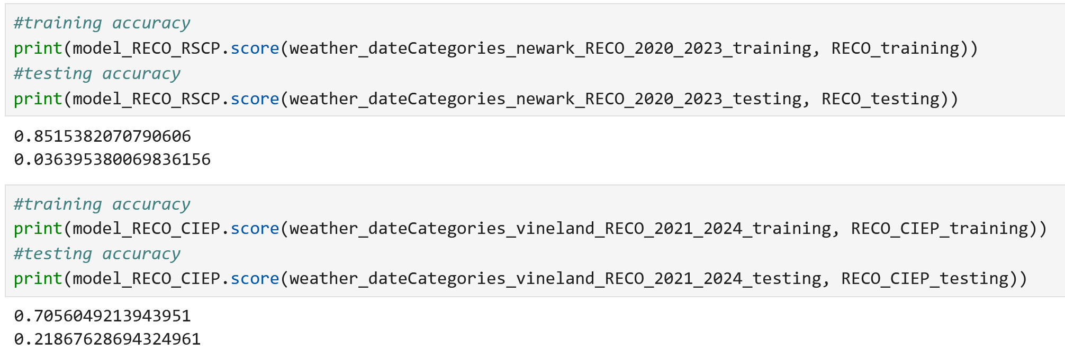
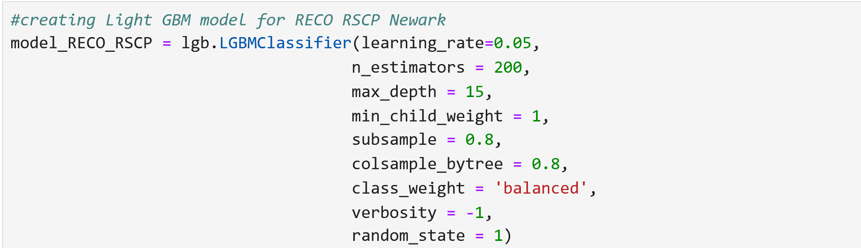
Model Performance
Training and Testing Accuracy
LGBM Parameters

Slide 11
Discussion
Limitations
Comparison to other works
Memorial University of Newfoundland --> localized energy consumption
Hypothesis
Energy usage is predicted through, temperature, humidity, and pressure.
Future work / directions /applications
Neural Networks
Hyperparameter tuning
Cross Validation

Slide 12
Citations
Elith, J., Leathwick, J.R. and Hastie, T. (2008), A working guide to boosted regression trees. Journal of Animal Ecology, 77: 802-813. https://doi.org/10.1111/j.1365- 2656.2008.01390.x
Madhukumar, M., Sebastian, A., Liang, X., Jamil, M., Shabbir, M. N. S. K. (2022). Regression model-based short-term load forecasting for university campus load. IEEE Access, 10, 8891-8905
X. Yao, X. Fu and C. Zong, ”Short-Term Load Forecasting Method Based on Feature Preference Strategy and LightGBM-XGboost,” in IEEE Access, vol. 10, pp. 75257-75268, 2022, doi: 10.1109/ACCESS.2022.3192011.
Di Persio, L.. and Fraccarolo, N. Energy Consumption Forecasts by Gradient Boosting Regression Trees https://doi.org/10.3390/math11051068
Title slide image: Utility Themes: Strategies and Spending.” ScottMadden, 30 Jan. 2024, www.scottmadden.com/insight/utility-themes-strategies-and-spending/.
Images on slides 2-4 from class slides for Constellation Project

